Slide 1
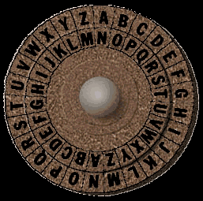
Caesar Ciphers
An Introduction to Cryptography

Slide 2
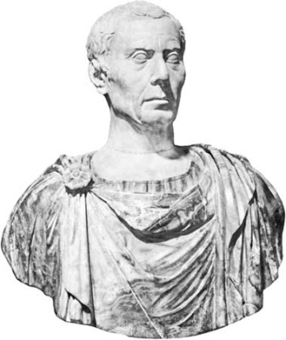
What is a Caesar Cipher?
Caesar used to encrypt his messages using a very simple algorithm, which could be easily decrypted if you know the key.
He would take each letter of the alphabet and replace it with a letter a certain distance away from that letter. When he got to the end, he would wrap back around to the beginning.
Example with a shift of 3:
I’m so sneaky!
A | B | C | D | E | F | G | H | I | J | K | L | M | N | O | P | Q | R | S | T | U | V | W | X | Y | Z
D | E | F | G | H | I | J | K | L | M | N | O | P | Q | R | S | T | U | V | W | X | Y | Z | A | B | C

Slide 3
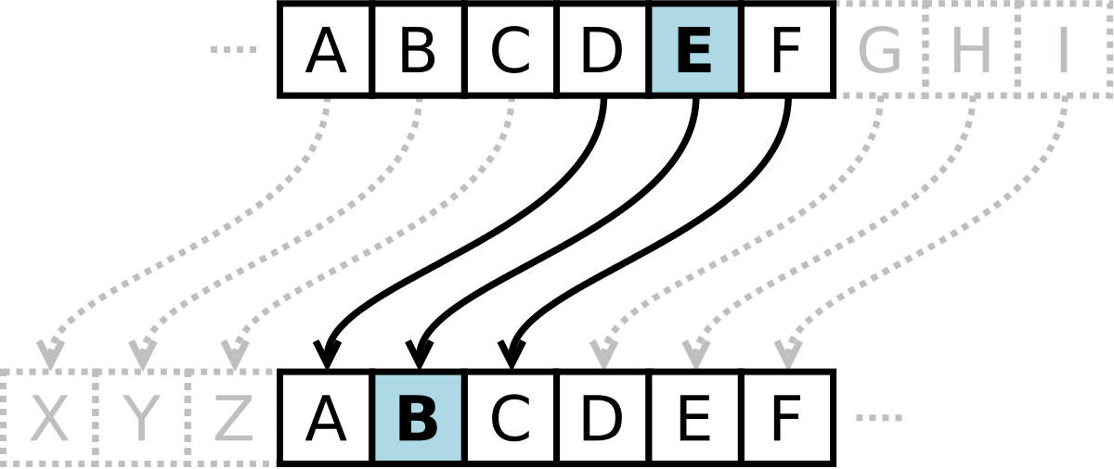

Slide 4
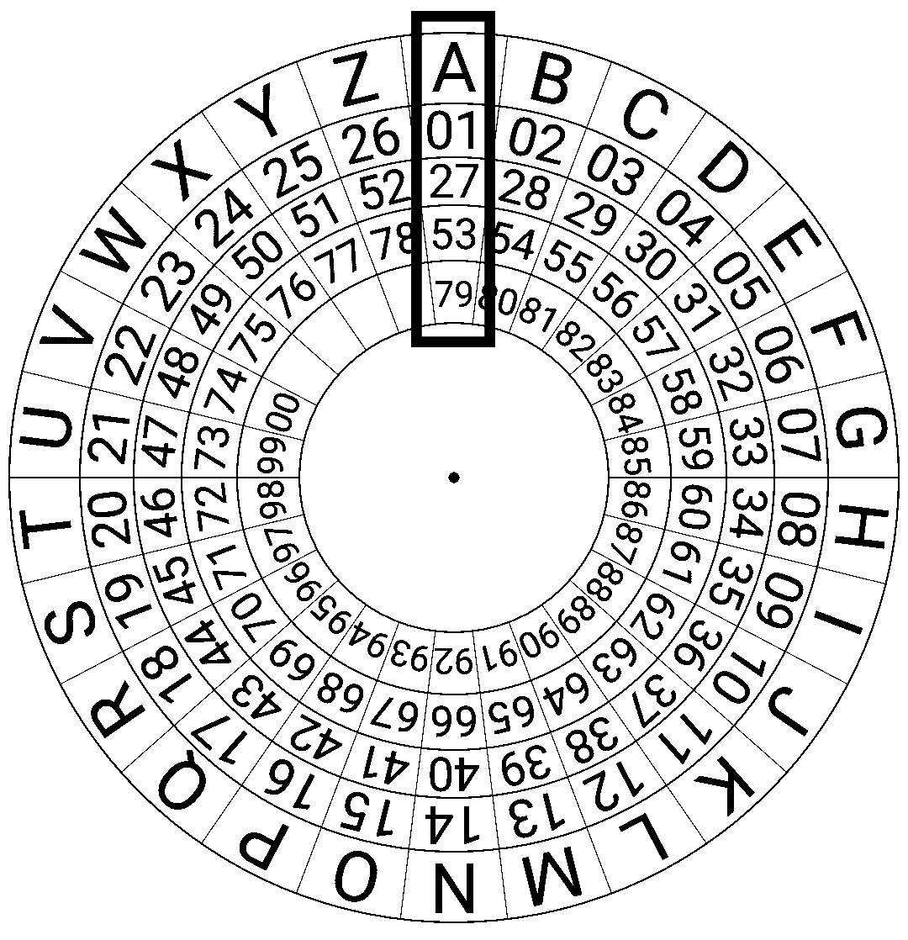

Slide 5
But I Don’t Want to Make a Table!
That’s fine! If you know what the shift is, you can use something called modulo, which is commonly shortened to mod.
Let’s say we wanted to find 8 mod 5. We would divide 8 by 5 and find the remainder. So in this case, 8 mod 5 = 3.
In this case, 5 is called the modulus.
Can you solve these?
19 mod 5 2 mod 5 25 mod 5
4 2 0

Slide 6
How Is That Helpful?
When using a Caesar cipher, you assign each letter to an index starting from 0.
You would then compute the following.
(plain letter index + key) mod (total number of letters)
This will give you the index of the encrypted letter!
As you can see, the modulus is the total number of letters in the alphabet. For English, this modulus is 26.
A | B | C | D | E | F | G | H | I | J | K | L | M | N | O | P | Q | R | S | T | U | V | W | X | Y | Z
0 | 1 | 2 | 3 | 4 | 5 | 6 | 7 | 8 | 9 | 10 | 11 | 12 | 13 | 14 | 15 | 16 | 17 | 18 | 19 | 20 | 21 | 22 | 23 | 24 | 25

Slide 7
A Simple Example
Let’s say we have a 5 letter alphabet with only the letters A-E
First, we assign each letter an index, starting from 0.
We then have to choose a key. For this example, we’ll use 2.
Let’s try encoding the word BEAD using the formula for the previous slide.
The index of the letter B is 1. The key is 2. The modulus is 5, since the alphabet is 5 letters.
Let’s use the algorithm: (1+2) = 3. 3 mod 5 = 3. The index of D is 3, so B would become the letter D.
Using algorithm on each letter, can you encode the full word?
DBCA
A | B | C | D | E
0 | 1 | 2 | 3 | 4

Slide 8
Why Does Modding Work?
The mod accounts for wrapping back around once you reach the end of the alphabet.
When converting the letter E using the key 2, you first add 4 + 2, which gives you 6. As you can see, the index 6 is beyond the scope of this alphabet. When you do 6 mod 5, you get the remainder of 1, which is how much you need to go back and count from the beginning of the alphabet.
A | B | C | D | E
0 | 1 | 2 | 3 | 4

Slide 9
What About Decoding?
To decode, you do the following:
(cipher letter index – key + total number of letters) mod (total number of letters)
Does anyone know why we can’t just do:
(cipher letter index – key) mod (total number of letters)?
By adding the total number of letters, you don’t have to end up taking the mod of a negative number.
See if you can decode DBCA to get back to the word BEAD.

Slide 10
How Would You Program This?
It’s unbelievably simple!
The mod function is one of the most basic components of a lot of programming languages. You’ll learn the mod function for python early on. That means all we have to deal with is indexing the letters.
Believe it or not, this also is no problem. The solution lies in ASCII.

Slide 11
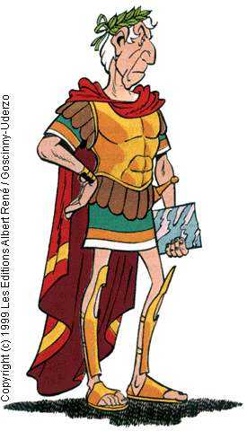
Wait, What’s ASCII?
Numbers associated with letters? This sounds strangely familiar…
Computers have to represent everything as numbers, including things as basic as text.
ASCII is the standard character encoding scheme, where each symbol is assigned a number.
These symbols range from upper and lower case letters to numbers to things like punctuation and arrows. There are many tables online that allow you to look up the number associated with each symbol.

Slide 12
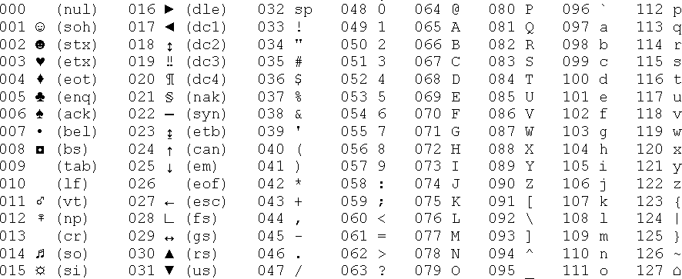
The ASCII Table

Slide 13
Using ASCII for Caesar’s Cipher
You probably noticed that the letter A is associated with the number 65, B with 66, C with 67, and so on.
Most programming languages have a function that can take a letter and find out it’s ASCII value.
What would you need to do to make the ASCII encoded letters usable for Caesar’s Cipher?
Subtract 65 from each letter!
Since it’s really simple to code for a computer to use mod and assign the correct index for each letter, you can probably see how programming a simple encoder/decoder would be a cinch!

Slide 14
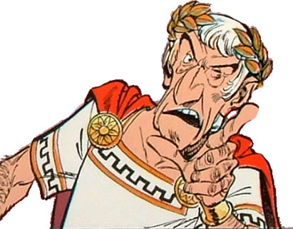
The Problem with Caesar’s Cipher
It’s too easy to break! Let’s go back to our five letter alphabet.
Say you had the word DBCA, but didn’t know the key. It would be easy to make a list of all possible keys. If you expected the unencrypted text to be in English, you could easily figure out which word was right:
If you were using the full English alphabet, this would take longer, but for someone trying to find our your secret, it’s a small price to pay!
Shift of 1 | CABE
Shift of 2 | BEAD ← The clear winner!
Shift of 3 | ADEC
Shift of 4 | ECDB
How dare you insult my cipher! Though, you have a good point…

Slide 15
Photo Encryption- Colors
We can apply what we’ve learned about encryption to pictures too!
As you may have noticed when using Photoshop, colors are determined by concentrations of red, green, and blue. The amount of each color is represented by a digit between 0 and 255.
For instance, red would be represented as
(255,0,0)
Red Green Blue

Slide 16
How It Works
This means that, just like words, we can convert all of our colors into numbers! This is helpful for encryption.
For instance, let’s say that one pixel of your image has a color value of (253,244,3). It looks like this:

Slide 17
How It Works
We want to send this color to someone else safely- do you have any idea how we can do this?
We can use a secret code, just like before!
Like the alphabet, we can shift our color values.
In this case, we are going to add another color’s value to our original value.

Slide 18
Adding Them Up
+
=
+
=
Notice that adding two color values together is not the same as mixing two colors (like you would when painting).

Slide 19
Adding Them Up- Mods
What if we add two color values together and their sum is greater than 255?
(60,45,300) → Not a color! The computer wouldn’t know what to do with this information.
This is where mods come in handy- like the Caesar Cipher, we have 256 values. This means that after you add two values together, you need to convert it to mod 256.
(60,45,300)→(60,45,44)

Slide 20
Decoding
To decode this color, all the recipient needs to do is subtract the color we added- in this case, we subtract the blue from the light yellow.
-
=

Slide 21
Applications
We just encoded and decoded one pixel. We can apply this to an entire picture by adding one image to another.
Think of it this way- You have a photo that you are sending and a photo that is your “key.” As long as the other person has the key, they can subtract it from your encoded photo to get back the original!
This isn’t particularly useful in computer science, however, because there is no way to stop someone from seeing your photo key and decoding it themselves. They could intercept this key (just like they could intercept the photo) if you try to send it to anyone or make it public!

Slide 22
An example
pixel addition

Slide 23
Cryptography
Cryptography is the study and practice of hiding information. Caesar’s cipher and photo encryption are just two ways to encrypt and decrypt information. They are both too weak for real-world applications.
There are many methods of cryptography that are much more foolproof than these two methods!
Later today, we will learn about one of these methods, RSA (public key) encryption.

